Slide 1

CS210- DBMS - ERD
4Th Semester - CSE

Slide 2

Unit 01: Introduction to DBMS & Relational Model Recap
▪ Module 01: Course Overview
▪ Why Databases?
▪ Course Overviews
▪ Module 02: Introduction to DBMS/1
▪ Levels of Abstraction
▪ Schema & Instance
▪ Data Models
▪ DDL & DML
▪ SQL
▪ Database Design
▪ Module 03: Introduction to DBMS/2
▪ Database Design
▪ Database Engine, Users, Architecture
▪ History of DBMS
▪ Module 04: Introduction to Relational Model/1
▪ Attribute Types
▪ Relation Schema and Instance
▪ Keys
▪ Relational Query Languages
▪ Module 05: Introduction to Relational Model/2
▪ Relational Operations
▪ Aggregate Operations

Slide 3
Unit 02: ER Modeling
▪ Module 6: Entity-Relationship Model/1
▪ Design Process
▪ E-R Model
▪ Module 7: Entity-Relationship Model/2
▪ E-R Diagram
▪ E-R Model to Relational Schema
▪ Module 8: Entity-Relationship Model/3
▪ Extended E-R Features
▪ Design Issues

Slide 4
WHY DATABASES? - Database Management System (DBMS)
DBMS contains information about a particular enterprise
Collection of interrelated data
Set of programs to access the data
An environment that is both convenient and efficient to use
Database Applications:
Banking: Account details and payment transactions
Airlines: Ticket reservations, Flight schedules
Universities: Student registration, grades
Sales: customers details, products details, purchases
Online retailers: Product order tracking, customized recommendations
Manufacturing: production, inventory, orders, supply chain reports
Human resources: employee records, salaries, tax deduction

Slide 5
Drawbacks : File systems
Data redundancy and inconsistency
Multiple file formats, duplication of information in different files
Difficulty in accessing data
Need to write a new program to carry out each new task
Atomicity of updates
Failures may leave database in an inconsistent state with partial updates carried out
Example: Transfer of funds from one account to another should either complete or not happen at all
Concurrent access by multiple users
Concurrent access needed for performance
Uncontrolled concurrent accesses can lead to inconsistencies
Example: Two people reading a balance (say 100) and updating it by withdrawing money (say 50 each) at the same time
Security problems
Hard to provide user access to some, but not all, data
*** Database systems offer solutions to all these problems

Slide 6
Module1 - Summary
Highlights the importance of database management systems in modern day applications
Introduced various aspects of the Course

Slide 7
Database Management Systems
Module 02: Introduction to DBMS-1

Slide 8
Module 2 - Objectives
To familiarize with the basic notions and terminology of database management systems
To understand the role of data models and languages
To understand the approaches to database design

Slide 9
Module 2- Outline
DBMS - Levels of Abstraction
DBMS - Schema & Instance
Data Models
Relational Databases
DBMS - DDL & DML
SQL
Database Design

Slide 10
Introduction to DBMS
Data : Data is a collection of a distinct unit of information Eg: Name, age, weight, height
Database : Collection of Logically interrelated structured data stored in a place.
DBMS : It is a software system. It allows Users to create, access, modify , maintain and control database
Eg: Ticket booking system ( Air, Railways, Transport), Student Library system, Student admissions , Banking applications, Amazon
Characteristics of DBMS
Shared : Multiuser and shared eg: users, applications
Validity : Correct information – eg: 123 invalid for name
Security : Protected ,authorized & limits the permissions [passwords, user control]
Consistency/integrity : consistent & recoverable across the database eg: phone number
Independence : three layers – Conceptual, External and physical
Persistence: Permanent and not deleted
No redundancy : same access to same data eg: same name id for different people
Multiple views of the same schema
Advantages
Reduced data redundancy : reduced updating errors and increased consistency.
Easier data integrity from application programs.
Improved data access to users through the use of query languages.
Higher Data security and Enforces Standards
Reduced cost : data entry, storage, and retrieval costs maintenance
Database
Types of DBMS:
Hierarchical DBMS : predecessor-successor type of relationship. Eg : Tree
Relational DBMS (RDBMS) : identify and access data in relation to another piece of data in the database. Data is stored in the form of Tables
Network DBMS : many to many relations where multiple user records can be linked
Object-oriented DBMS: uses small individual software called objects. object contains a piece of data and the instructions for the actions to be done with the data
No SQL and Cloud DBMS : latest's trends of DBMS due to speed, internet and unstructured data needs
Ticket booking system
Disadvantages
Cost: DBMS are licensed, large in size and need time to setup.
Complexity: Risk of data loss due to storing their data in a single database
Compatibility :Incompatibility of DBMS with an organization’s operational requirements.
Security : Confidential data storage

Slide 11
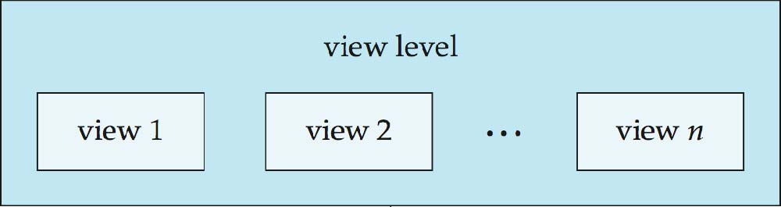
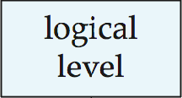
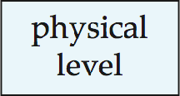
Database Abstraction, Levels
Data abstraction : Provides only information that is useful and required by users such as DBAs, System Analysts, Programmers, End users
Levels :
Internal ( physical ) : System analysts. Closest to storage, describes how data is stored in storage media
External ( View) : End users – Describes the way data is viewd by users
Conceptual( logical) : Describes - What data is stored , the relationships among the data, the data structure used in DB
SA
Student
View 1
View 2
View 3
Admin
Conceptual/Logical Layer
Data structure, Tables
Physical Layer
storage
DBMS – Architecture

Slide 12
Database Architecture
Application Programmer
DBMS Software ( Data retrieves and updates)
MIDDLEWARE
Database storage (data + programs)
Data entry Applications
Database administrator
Reports Application
End user

Slide 13
Table1: CourseDetails
Primary Key
Course_id | Name | Faculty advisor | phone
1 | ECE | Dr. Rajesh | 93456890
2 | CS | Dr.Sunita | 97896450
3 | ECE | Dr. Ram | 9345690
User1
DBMS Software ( Data retrieves and updates)
MIDDLEWARE
Data entry Applications
Database storage (data + programs)
Programmer
Reports Application
Admin

Slide 14
Difference between File System and DBMS
File management System :
Access Control, Security, Data redundancy , Data Dependency
Small system
Simple structure
Cheap
Very low design
Not secure
Single user
Isolated data
Back up mechanism
DBMS management :
Access Control, Security, Data redundancy , Data Dependency
Large system
Complex structure
Expensive
Very low design
secure
Multi user
Shared data
Complex Back up mechanism
File 1
File 2
DBMS Software MIDDLEWARE
Database storage (data + programs)
User1
Data entry Applications
Admin
Reports Application

Slide 15
Introduction to SQL
SQL :
Structured Query language SQL is pronounced as “S-Q-L” or sometimes as “See-Quel”. It is a standard language for dealing with Relational Databases.
SQL was developed in the 1970s at IBM Corporation, Inc., by Donald Chamberlin and Raymond F Boyce.
1970 - Started with R , 1986-ANSI ( SQL standard) , 2008 - latest ISO SQL standard
Effectively used to insert, search, update, delete, modify database records of Relational Databases.
SQL is regularly used by both database administrators and developers.
Difference between SQL and MySQL:
SQL is a standard language which is used to operate on database in the form of queries . MySQL is Open Source Database Management System or Software. MySQL will organize and then store the data in its database.
SQL Syntax : Examples
CREATE DATABASE databasename;
DROP DATABASE databasename;
CREATE TABLE Student (
studentID int,
FName varchar(25),
LName varchar(25),
Address varchar(50),
City varchar(15),
Marks int);
Select column 1, column 2…..column N
From Table;
SQL :
DML (Data manipulation Language)
DDL (Data definition Language)
DCL (Data control language)

Slide 16
No SQL
NO SQL Database
NoSQL databases are called "Not Only SQL" or "Non-relational" databases.
NoSQL databases store and retrieve data other than tabular relations such as relation databases.
Eg: NoSQL databases include MongoDB, HBase, and Cassandra.

Slide 17
No SQL
There are following properties of NoSQL databases.
Design Simplicity
Horizontal Scaling
High Availability
NoSQL databases are increasingly used in Big Data and real-time web applications.
NoSQL databases are sometimes called Not Only SQL i.e. they may support SQL-like query language.

Slide 18
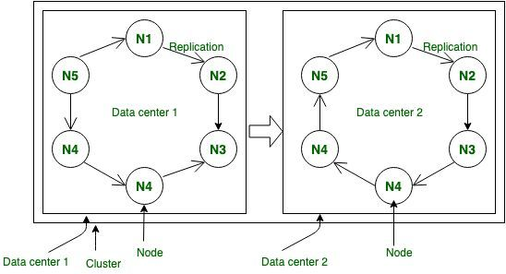
No SQL (Cassandra) Database Architecture
Cassandra works with peer to peer architecture, with each node connected to all other nodes. Each Cassandra node performs all database operations and can serve client requests without the need for a master node.
Cassandra is famous for being a Schema-less/schema-free database in its column family. Cassandra data model is also famously known as a schema-optional data model

Slide 19
CQL (Cassandra)
CQL offers a model close to SQL in the sense that data is put in tables containing rows of columns.
For that reason, when used in this document, these terms (tables, rows and columns) have the same definition than they have in SQL.
Data modelling in Cassandra :
https://cassandra.apache.org/doc/latest/cql/
https://cassandra.apache.org/doc/latest/data_modeling/index.html

Slide 20
No SQL (Cassandra) Database Vs Relational databases
Relational Database | NoSQL Database
Handles data coming in low velocity | Handles data coming in high velocity
Data arrive from one or few locations | Data arrive from many locations
Manages structured data | Manages structured unstructured and semi-structured data.
Supports complex transactions (with joins) | Supports simple transactions
single point of failure with failover | No single point of failure
Handles data in the moderate volume. | Handles data in very high volume
Centralized deployments | Decentralized deployments
Transactions written in one location | Transaction written in many locations
Gives read scalability | Gives both read and write scalability
Deployed in vertical fashion | Deployed in Horizontal fashion

Slide 21
No SQL - Apache Cassandra Database
Massively Scalable Architecture: Cassandra has a (masterless) design where all nodes are at the same level which provides operational simplicity and easy scale out.
Masterless Architecture: Data can be written and read on any node.
Linear Scale Performance: As more nodes are added, the performance of Cassandra increases.
No Single point of failure: Cassandra replicates data on different nodes that ensures no single point of failure.
Fault Detection and Recovery: Failed nodes can easily be restored and recovered.
Flexible and Dynamic Data Model: Supports datatypes with Fast writes and reads.
Data Protection: Data is protected with commit log design and build in security like backup and restore mechanisms.
Tunable Data Consistency: Support for strong data consistency across distributed architecture.
Multi Data Center Replication: Cassandra provides feature to replicate data across multiple data center.
Data Compression: Cassandra can compress up to 80% data without any overhead.
Cassandra Query language: Cassandra provides query language that is similar like SQL language. It makes very easy for relational database developers moving from relational database to Cassandra.

Slide 22
SQL ( DDL ,DML and DCL)
Course_id | Name | Faculty advisor
1 | ECE | Dr. Rajesh
2 | CS | Dr.Sunita
Student_id | Name | Course_id
1000 | Arun | 1
1200 | Srilatha | 2
Table1: Student Details
Table 2: FacultyAdvisorDetails
DDL : Manipulation of Data in Tables using SQL query Various operations of DDL : Create data tables, views , indexes Type of data divisions : data items, segments, records Provide Unique name to data items Define range of values Provide means of checking errors in the database Provide locks for security Example of DDL: Create Table Student ( Student_id (int), Name varchar(25) Course_id (int) );
2. DML: Creation and manipulation of Schema of Views Database Various operations of DML : Insertion of new record (INSERT) Remove data items (DELETE) Update or modify data items or records (UPDATE/ALTER) Retrieve data items from the tables (SELECT) Example of DML : 3. DCL: Control Access of the Database Grant access Revoke

Slide 23
DBMS - Schemas and Instances
Schemas are considered similar to types and variables in programming languages
1. Schema
Logical Schema – the overall logical structure of the database
Analogous to type information of a variable in a program
Example: The database consists of information about a set of customers and accounts in a bank and the relationship between them
Customer- details : Schema
Name | Customer ID | Account # | Aadhaar ID | Mobile #
Account details : Schema
Account # | Account Type | Interest Rate | Min. Bal. | Balance
2. Physical Schema– the overall physical structure of the database

Slide 24
DBMS : Schemas and Instances
Instance
The actual content of the database at a particular point in time
Similar to the value of a variable
Customer Instance
Name | Customer ID | Account_No | Aadhaar_no | Mobile #
Sindhuja | 100020 | 20000 | 546909289372 | 9990809890
Suresh | 100040 | 25000 | 443291204829 | 8890789067
Chandra Kimar | 100050 | 27000 | 345690291021 | 9892029092
Account Instance
Account # | Account_Type | ROI | Min. Bal. | Total Balance
20000 | Savings | 4.0% | 4000 | 7812
25000 | Current | 0.0% | 0 | 291820
27000 | Term Deposit | 6.75% | 15000 | 100000

Slide 25
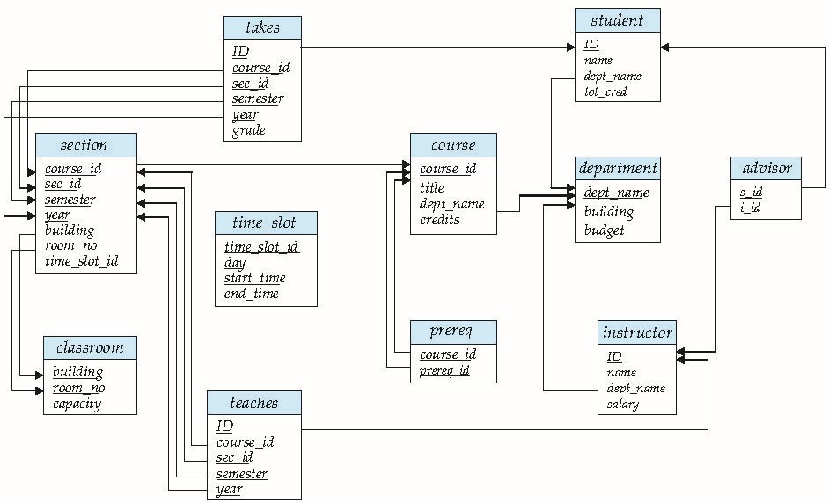
Schema Diagram for University Database

Slide 26
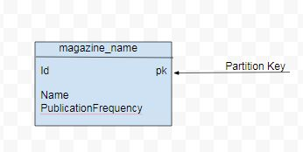
DBMS – Data modeling
Data modeling is the process of identifying entities and their relationships.
In relational databases,
Data is placed in normalized tables with foreign keys used to reference related data in other tables. Queries that the application will make are driven by the structure of the tables and related data are queried as table joins.
In NoSQL (Cassandra), data modeling is query-driven. The data access patterns and application queries determine the structure and organization of data which then used to design the database tables
CREATE TABLE magazine_name (id int PRIMARY KEY, name text, publicationFrequency text)

Slide 27
DBMS - Data Independence
Physical Data Independence – the ability to modify the physical schema without changing the logical schema
In general, the interfaces between the various levels and components should be well defined so that changes in some parts do not seriously influence others.

Slide 28
Terminologies of Relational Data Model
Properties
Relation : A Table arranged in rows and columns
All entries are of same type in columns
For a row, each column should of atom value
All rows are distinct . Two rows are not same
Columns names must be distinct
Domain :
Pool of values from which column values are derived
Tuple: Rows of the Table
Attributes : Columns of the Table
Degree of relation : Number of attributes
Cardinality of relation : Number of Tuples
Relation : StudentDetails
Student_id | Name | Course_id
1000 | Arun | 1
1200 | Srilatha | 2
1250 | Venu | 3
Example :
Relation : Student Details
Domain of Student_id = 1000,1200
Course_id = 1,2
Tuples = Three rows
Attributes of Relation “StudentDetails” = Student_id,
Name,Course_id
Cardinality of Relation “StudentDetails” = 3
Degree of Relation “StudentDetails” = 3

Slide 29
Views
View :
It is virtual Table does not exist and derives from physical Table
Names of those Views are stored in the Database
Views can e used as Tables and all the operations of Tables are applicable to Views
Examples
Create View Course1 as
Select * from StudentDetails where Course_id = 1
Create View Course1 as
Select * from StudentDetails where Course_id = 1
Student_id | Name | Course_id
1000 | Arun | 1
1200 | Srilatha | 2
1300 | Vasu | 1
1250 | Joy | 1
1400 | Abdul | 2
Student Details

Slide 30
Types of keys in relation
Relation : Student Details
Candidate Keys
Primary Keys :
It is set of one or more attributes having unique values within the relation and thus uniquely able to identify the tuple or record. Relation may have more than one Primary Key . Other keys are called Alternate key
2. Candidate Key :
All attribute combinations that can serve as Primary keys are called candidate keys
Eg : 1. Candidate Keys -> (Student_id, Book_id)
2. Combination of Candidates keys (Super Key)
3. Alternate Keys:
It is a Primary key but not selected as Primary key
4. Foreign Key :
IT represents relation ship between two Relations and Key is used to connect between two relations.
Student_id | Name | Course_id | Book_id
1000 | Arun | 1 | 21
1200 | Joy | 2 | 40
1300 | Vasu | 1 | 200
1250 | Joy | 1 | 130
1400 | Abdul | 2 | 150
Primary Keys
Foreign Keys
Super Key -> (Student_Id and Book_id)
Relation : Book Details
Book_id | Author name | Issue_date | Price(Rs)
21 | Krishna | 05032020 | 500
40 | Ram | 18072020 | 250
200 | Jaan | 10052020 | 450
130 | Reta | 10072020 | 1100
150 | Sham | 12032020 | 700
Primary Keys

Slide 31
Data Models
Network Data Model :
Data is organized as records and relationship among data is represented as links.
Record is a collection of attributes. Each contains one data value
Link is associated between two records
Relational Data Model :
Data is organized into Tables as Rows and Columns. Table is called as Relation. Rows are called Tuples and Columns are called Attributes
Foreign Key: Book_id
Student_id | Name | Course_id | Book_id
1000 | Arun | 1 | 21
1200 | Joy | 2 | 40
1300 | Vasu | 1 | 200
1250 | Joy | 1 | 130
1400 | Abdul | 2 | 150
Relation : Student Details
Student_id | Name | Course_id | Book_id
Book_id | Author name | Issue_date | Price(Rs)
Primary Key: Book_id
Book_id | Author name | Issue_date | Price(Rs)
21 | Krishna | 05032020 | 500
40 | Ram | 18072020 | 250
200 | Jaan | 10052020 | 450
130 | Reta | 10072020 | 1100
150 | Sham | 12032020 | 700
1000 | AA | c11 | 21
21 | A | 200320 | 150
Relation : Book Details
11200 | AA | c11 | 21
40 | 200320 | 150 | 200320
Relation : Student Details
Book Details

Slide 32
Data models
3. Hierarchical Data Models:
Data or records are organized as Tree structure. It is otherwise similar to Network Data model( Arbitrary graphs)
Each entity has one Parent and many children ( parent child relationship)
Student_id | Name | Course_id | Book_id
Book_id | Author name | Issue_date | Price(Rs)
Course_id | name | Faculty | Credits
Book_id | Publisher name | Publication year | location
Course_id | Dep name | Faculty | exp

Slide 33
Normalization
What -> It is a process of analyzing a schema based on Functional dependency and primary keys
Why -> Minimize redundancy and minimize anomalies (update, delete, insert)
Anomalies :
Student(name, course, phone, faculty, grade)
Keys : (name, course)
Functional dependency : name -> phone
course -> faculty
Name, course -> grade
Redundancy -> store same data multiple times

Slide 34
SQL Online
https://www.jdoodle.com/execute-sql-online/
https://www.w3schools.com/sql/trysql.asp?filename=trysql_asc
https://paiza.io/projects/_3q-vDZUpVJV4XV1dzXpxg?language=mysql
https://www.indiabix.com/database/introduction-to-sql/104001
https://www.examtiger.com/mcq/sql-query-language/

Slide 35
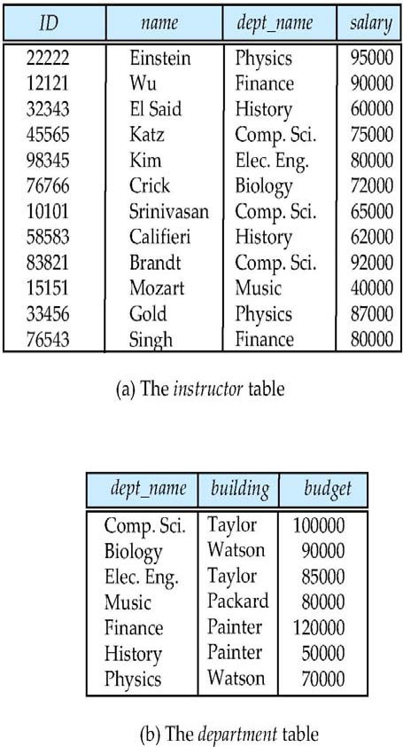
A Sample Relational Database

Slide 36
DBMS- Database Design
The process of designing the general structure of the database:
Logical Design – Deciding on the database schema. Database design requires that we find a “good” collection of relation schemas.
Business approach
What attributes should we record in the database?
Other approach
What relation schemas should we have and how should the attributes be distributed among the various relation schemas?
Physical Design – Deciding on the physical layout of the database

Slide 37
Module2 - Summary
Familiarized with the basic notions and terminology of database management systems
Introduced the role of data models and languages
Introduced the approaches to database design

Slide 38
Database Management Systems
Module 03: Introduction to DBMS -2

Slide 39
Module 3- Objectives
To understand models of database management systems
To familiarize with major components of a database engine
To familiarize with database internals and architecture
To understand the historical perspective

Slide 40
Module 3- Outline
Relational Database Design Overview
Database Engine
Storage Management
Query Processing
Transaction Management
Database Users and Administrators
Database Internals & Architecture
History of DBMS(self study)

Slide 41
Database Design
The process of designing the general structure of the database:
Logical Design
Deciding on the database schema. Database design requires that we find a “good” collection of relation schemas.
Business approach
What attributes should we record in the database?
Other approach
What relation schemas should we have and how should the attributes be distributed among the various relation schemas?
Physical Design
Deciding on the physical layout of the database

Slide 42
Database Design Approaches
For a good data base design minimize the Data anomalies, conflicts, redundancy
Two ways of doing so:
Entity Relationship Model :
Models an enterprise as a collection of entities and relationships
Represented diagrammatically by an entity-relationship diagram:
Normalization Theory:
Identifies the improvement in Databases by removing Data anomalies.

Slide 43
Database Engine
Storage manager
Query processing
Transaction manager

Slide 44
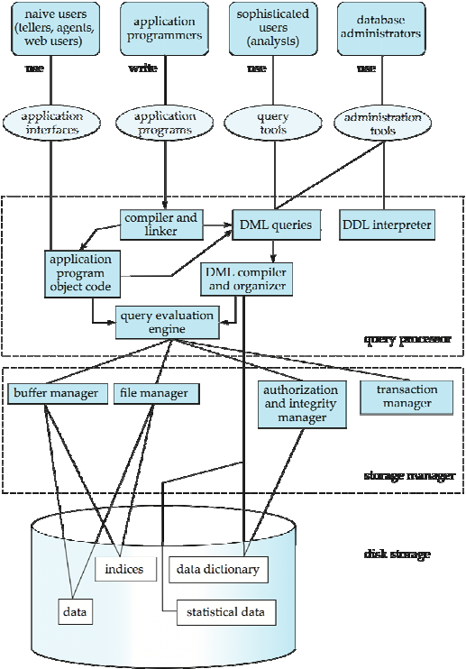
Database System Internals

Slide 45
Storage Management
Storage manager is a program module that provides the interface between the low-level data stored in the database and the application programs and queries submitted to the system.
The storage manager is responsible for:
Interaction with the OS file manager
Efficient storing, retrieving and updating of data
Challenges:
Storage access
File organization
Indexing and hashing

Slide 46
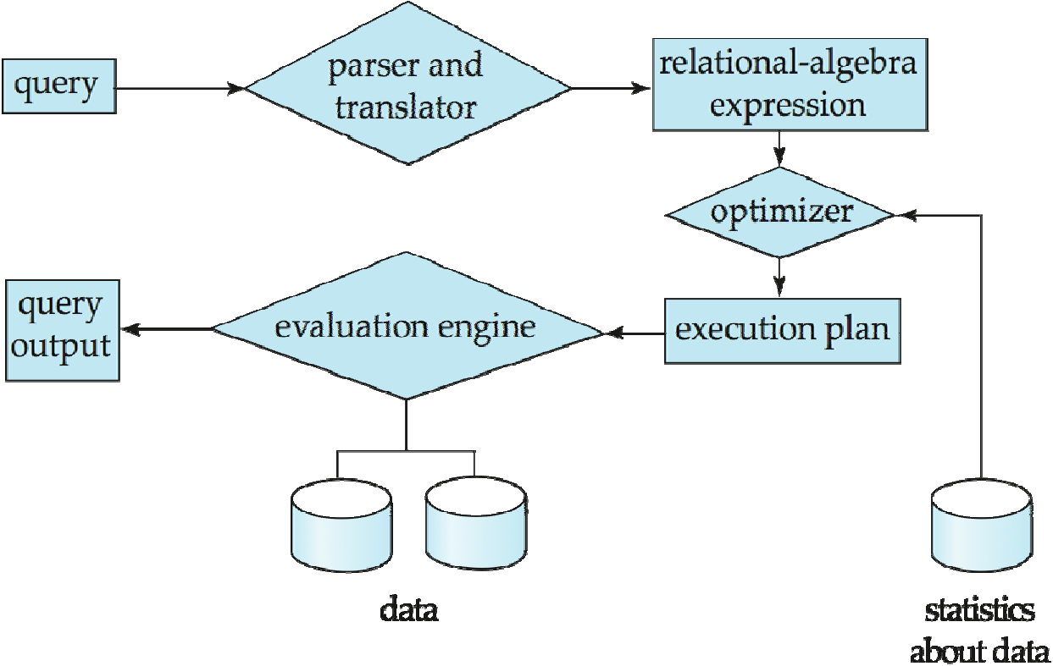
Query Processing
Parsing and translation
Optimization
Evaluation

Slide 47
Query Processing (Cont.)
Alternative ways of evaluating a given query
Equivalent expressions
Different algorithms for each operation
Cost difference between a good and a bad way of evaluating a query can be enormous
Need to estimate the cost of operations
Depends critically on statistical information about relations which the database must maintain
Need to estimate statistics for intermediate results to compute cost of complex expressions

Slide 48
Transaction Management
What if the system fails?
What if more than one user is concurrently updating the same data?
A transaction is a collection of operations that performs a single logical function in a database application
Transaction-management component ensures that the database remains in a consistent (correct) state despite system failures (e.g., power failures and operating system crashes) and transaction failures.
Concurrency-control manager controls the interaction among the concurrent transactions, to ensure the consistency of the database.

Slide 49
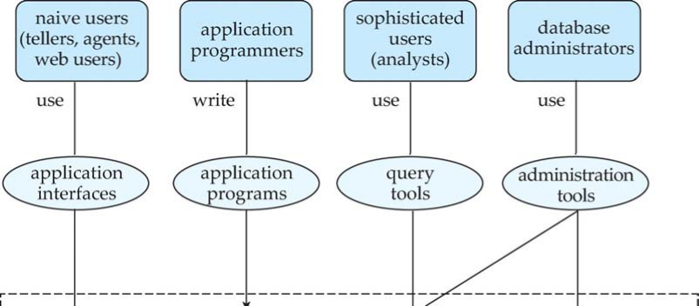
Database Users and Administrators
Database

Slide 50
Database Architecture
The architecture of a database systems is greatly influenced by the underlying computer system on which the database is running:
Client-server
Centralized (Explore)
Parallel (multi-processor) (Explore)
Distributed (Explore)

Slide 51
History of Database Systems (self -study)
1950s and early 1960s:
Data processing using magnetic tapes for storage
Tapes provided only sequential access
Punched cards for input
Late 1960s and 1970s:
Hard disks allowed direct access to data
Network and hierarchical data models in widespread use
Ted Codd defines the relational data model
Would win the ACM Turing Award for this work
IBM Research begins System R prototype
UC Berkeley begins Ingres prototype
High-performance (for the era) transaction processing

Slide 52
History (cont.) – ( self study)
1980s:
Research relational prototypes evolve into commercial systems
SQL becomes industrial standard
Parallel and distributed database systems
Object-oriented database systems
1990s:
Large decision support and data-mining applications
Large multi-terabyte data warehouses
Emergence of Web commerce
Early 2000s:
XML and XQuery standards
Automated database administration
Later 2000s:
Giant data storage systems
Google BigTable, Yahoo PNuts, Amazon, ..

Slide 53
Module 3- Summary
Introduced models of database management systems
Familiarized with major components of a database engine
Familiarized with database internals and architecture

Slide 54
Database Management Systems
Module 04: Introduction to Relational Model - 1

Slide 55
Module 4 - Objectives
To understand attributes and their types
To understand the mathematical structure of relational model – schema, instance and keys
To familiarize with different types of relational query languages

Slide 56
Module4 - Outline (self study)
Attribute Types (Self Study)
Relation Schema and Instance (Self Study)
Keys (Self Study)
Relational Query Languages

Slide 57
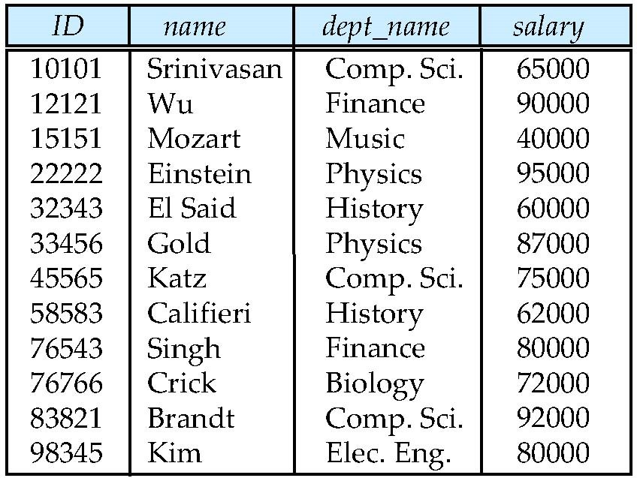
Example of a Relation
attributes (or columns)
tuples (or rows)

Slide 58
Attributes - Attribute Types
The set of allowed values for each attribute is called the domain of the attribute
Roll #: Alphanumeric string
First Name, Last Name: Alpha String
DoB: Date
Passport #: String (Letter followed by 7 digits) – nullable
Aadhaar #: 12-digit number
Department: Alpha String
Attribute values are (normally) required to be atomic; that is, indivisible
The special value null is a member of every domain. Indicated that the value is “unknown”
The null value causes complications in the definition of many operations
Roll # | First Name | Last Name | DoB | Passport # | Aadhaar # | Department
15CS10026 | Lalit | Dubey | 27-Mar-1997 | L4032464 | 1728-6174-9239 | Computer
16EE30029 | Jatin | Chopra | 17-Nov-1996 | null | 3917-1836-3816 | Electrical

Slide 59
Relations - Schema and Instance
A₁, A₂, …, A_{n} are attributes
R = (A₁, A₂, …, A_{n} ) is a relation schema
Example:
instructor = (ID, name, dept_name, salary)
Given sets D₁, D₂, …. D_{n} a relation r is a subset of D₁ x D₂ x … x D_{n}
Thus, a relation is a set of n-tuples (a₁, a₂, …, a_{n}) where each a_{i is part of} D_{i}
The current values (relation instance) of a relation are specified by a table.
An element t of r is a tuple, represented by a row in a table

Slide 60
Relations - Keys
K is a superkey of R if values for K are sufficient to identify a unique tuple of each possible relation r(R)
instructor = (ID, name, dept_name, salary)
Example: {ID} and {ID,name} are both superkeys of instructor
Superkey K is a candidate key if K is minimal
Example: {ID} is a candidate key for Instructor
One of the candidate keys is selected to be the primary key
Which one?

Slide 61
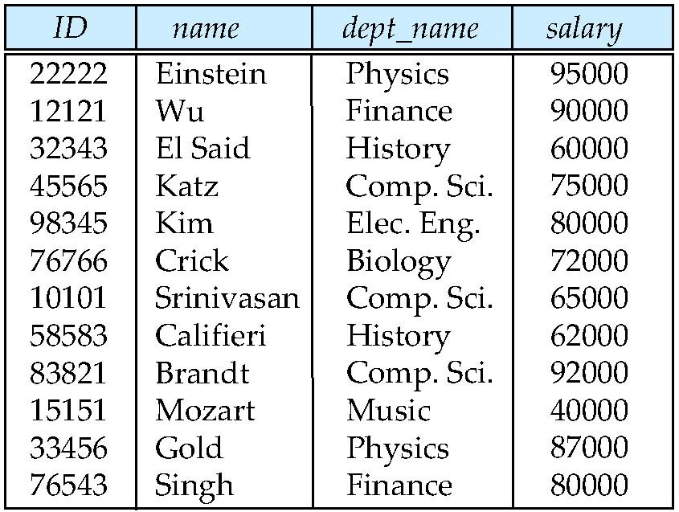
Relations - Characteristics - Unordered
Order of tuples is irrelevant (tuples may be stored in an arbitrary order)
Example: instructor relation with unordered tuples

Slide 62
Schema Diagram for University Database

Slide 63
Relations : Keys Example
Super Key: Roll #, {Roll #, DoB}
Candidate Keys: Roll #, {First Name, Last Name}, Passport #, Aadhaar #
Passport # cannot be a key. Why?
Null values are allowed for Passport # (a student may not have a passport)
Primary Key: Roll #
Secondary / Alternate Key: {First Name, Last Name}, Aadhaar #
Simple key: Consists of a single attribute
Composite Key: {First Name, Last Name}
Consists of more than one attribute to uniquely identify an entity occurrence
One or more of the attributes, which make up the key, are not simple keys in their own right
Roll # | First Name | Last Name | DoB | Passport # | Aadhaar # | Department
15CS10026 | Lalit | Dubey | 27-Mar-1997 | L4032464 | 1728-6174-9239 | Computer
16EE30029 | Jatin | Chopra | 17-Nov-1996 | null | 3917-1836-3816 | Electrical
15EC10016 | Smriti | Mongra | 23-Dec-1996 | G5432849 | 2045-9271-0914 | Electronics
16CE10038 | Dipti | Dutta | 02-Feb-1997 | null | 5719-1948-2918 | Civil
15CS30021 | Ramdin | Minz | 10-Jan-1997 | X8811623 | 4928-4927-5924 | Computer

Slide 64
Keys
Foreign key constraint: Value in one relation must appear in another
Referencing relation
Enrolment: Foreign Keys – Roll #, Course #
Referenced relation
Students, Courses
A compound key consists of more than one attribute to uniquely identify an entity occurrence
Each attribute, which makes up the key, is a simple key in its own right
{Roll #, Course #}
Students
Roll # | First Name | Last Name | DoB | Passport # | Aadhaar # | Department
Courses
Enrolment
Course # | Course Name | Credits | L-T-P | Department
Roll # | Course # | Instructor ID

Slide 65
Relational Query Languages
Relational algebra
Tuple relational calculus
Domain relational calculus

Slide 66
Module 4 - Summary
Introduced the notion of attributes and their types
Taken an overview of the mathematical structure of relational model – schema and instance
Introduced the notion of keys – primary as well as foreign

Slide 67

Database Management Systems
Module 05: Introduction to Relational Model - 2

Slide 68
Module 5 - Objectives
To understand relational algebra
To familiarize with the operators of relational algebra

Slide 69
Module 5 - Outline
Operations Overview
Select
Project
Union
Difference
Intersection
Cartesian Product
Natural Join
Aggregate Operations Overview

Slide 70
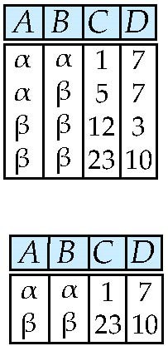
Relational Operations - Select
1. Select Operation – selection of rows (tuples)
Relation r
^{σ}A=B ^ D > 5 ^{(r)}

Slide 71
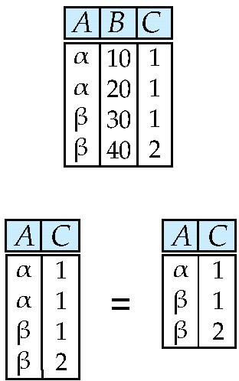
Relational Operations - Project
2. Project Operation – selection of columns (Attributes)
Relation r
▪
∏_{A,C} (r)

Slide 72
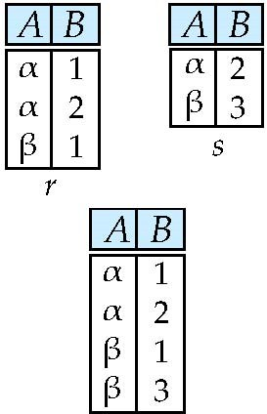
Relational Operations – Union
3. Union
Relations r, s:
r ∪ s:

Slide 73
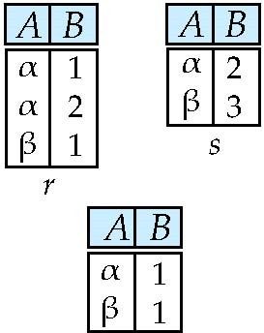
Relational Operations - Set difference
4. Set difference of two relations
Relations r, s:
r – s:

Slide 74
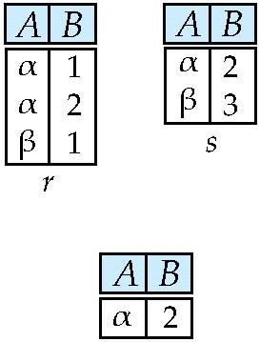
Relational Operations - Set intersection
5. Set intersection
Relation r, s:
r ∩ s
Note: r ∩ s = r – (r – s)

Slide 75
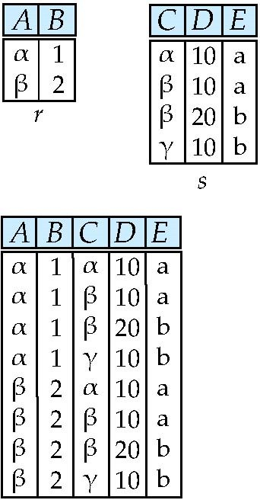
Relational Operations - Cartesian-product
6. Cartesian-product
Relations r, s:
r x s:

Slide 76
Relational Operations – Rename
7. Rename
Allows us to refer to a relation, (say E) by more than one name.
ρ _{x} (E)
returns the expression E under the name X
Relations r
r x ρ _{s} (r)
r.A
r.B
s.A
s.B
α | 1 | α | 1
α | 1 | β | 2
β | 2 | α | 1
β | 2 | β | 2

Slide 77
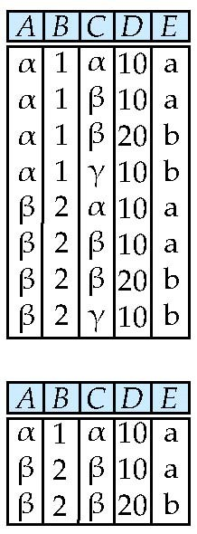
Composition of Operations
Can build expressions using multiple operations
Example: σ_{A=C} (r x s)
r x s
σ_{A=C} (r x s)

Slide 78
Joining two relations – Natural Join
Let r and s be relations on schemas R and S respectively. Then, the “natural join” of relations R and S is a relation on schema R ∪ S obtained as follows:
Consider each pair of tuples t_{r} from r and t_{s} from s.
If t_{r} and t_{s} have the same value on each of the attributes in R ∩ S, add a tuple t to the result, where
t has the same value as t_{r} on r
t has the same value as t_{s} on s

Slide 79
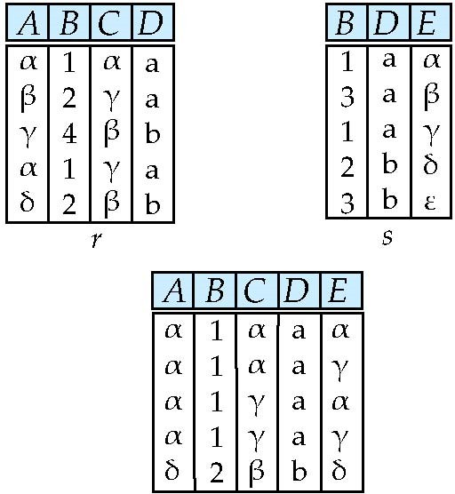
Joining two relations – Natural Join
Relations r, s:
Natural Join
n r s
∏ A, r.B, C, r.D, E ^{(σ} r.B = s.B ˄ r.D = s.D ^{(r x s)))}

Slide 80
Aggregate Operators
we compute:
SUM
AVG
MAX
MIN

Slide 81
Relational Languages
Each Query input is a table (or set of tables)
Each query output is a table
All data in the output table appears in one of the input tables
Relational Algebra is not Turning complete

Slide 82
Summary- Relational Languages
Symbol (Name)
Example of Use
σ
(Selection)
σ _{salary > = 85000} (instructor)
Return rows of the input relation that satisfy the predicate.
Π
(Projection)
Π _{ID, salary} (instructor)
Output specified attributes from all rows of the input relation. Remove duplicate tuples from the output.
x
(Cartesian Product)
instructor x department
Output pairs of rows from the two input relations that have the same value on all attributes that have the same name.
∪
Π _{name} (instructor) ∪ Π _{name} (student)
(Union)
Output the union of tuples from the two input relations.
-
Π _{name} (instructor) ‐‐ Π _{name} (student)
(Set Difference)
Output the set difference of tuples from the two input relations.
⋈
(Natural Join)
instructor ⋈ department
Output pairs of rows from the two input relations that have the same value on all attributes that have the same name.

Slide 83
Module 5 - Summary
Introduced relational algebra
Familiarized with the operators of relational algebra

